Slide 1
Firmware
Over The Air (FOTA)
Supervised By : Prof. Dr. Hesham Tolba

Slide 2
Agenda
01
Introduction
02
Problem Statement
03
Market Research
04
System Overview

Slide 3
Agenda
05
Communication Protocols
06
Bootloader
07
Server
08
User ECU

Slide 4
Agenda
09
Application ECU
10
Main ECU
11
Hardware Implementation
12
Future Work

Slide 5
Problem Statement
A condition to be improved upon, a difficulty to be eliminated, or a troubling question that exists in theory

Slide 6
Problem Statement
Losses Increase
Increased losses for both the manufacturer and the customer due to wasting time and money and affecting the reputation of the manufacturer
Losses Increase
New Features
Allows manufacturers to remotely install new software updates, features and services - even after a device has been purchased.
Appearance of Bugs
New Features
Allows manufacturers to repair bugs in new units
Appearance of Bugs
Vehicle Evolution
In Automotive a car had at least 20 million to 30 million lines of code and 100 to 200 different ECU.
Vehicle Evolution

Slide 7
FOTA Benefits
Cost-effective
3
4
Ability to penetrate the market
This feature save techs the hassle of traveling to fix bugs and similar problems on-site; hence it's more time-efficient for them as well as customers.
Every IoT device must be reliably designed and affordably produced. This gives engineers an easy time to coordinate and update every device.
Encourages evolution
1
2
Low risks
FOTA has the advantage of speed over other IoT products as it can be pre-assembled and pre-installed within minutes.
FOTA allows them to configure devices long after they have been purchased, enabling them to stay updated on emerging technology trends and evolving industry standards.
FOTA

Slide 8
Market Research
Discover the target market and get opinions and other feedback from consumers about their interest in the service.

Slide 9

Market Research

Slide 10
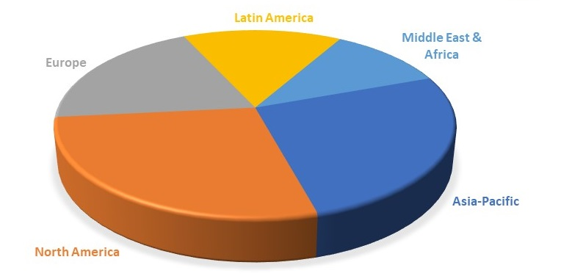
Market Research

Slide 11
System Overview

Slide 12







FOTA Services
CONTROL
Optimize operations while delivering a great customer experience
UPDATE
Keep devices updated over their entire lifecycle, without costly service trips
FIX
Firmware update facilitates bug fixing, enhancements, and security patch updates
SECURE
Secure system through data integrity and source authentication
OEMs

Slide 13

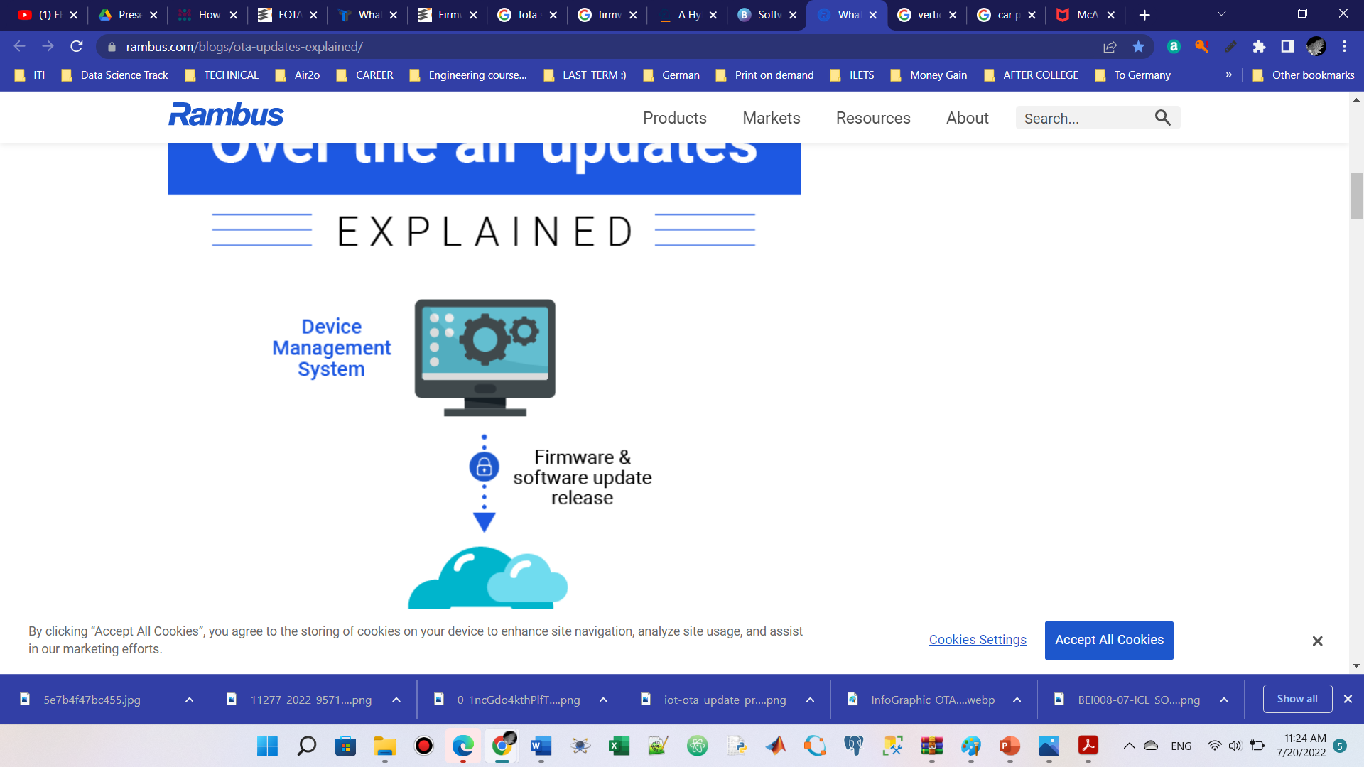
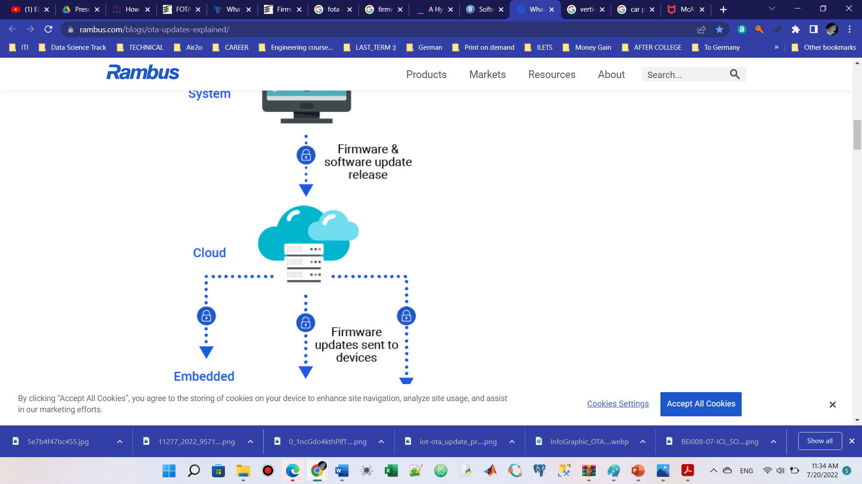

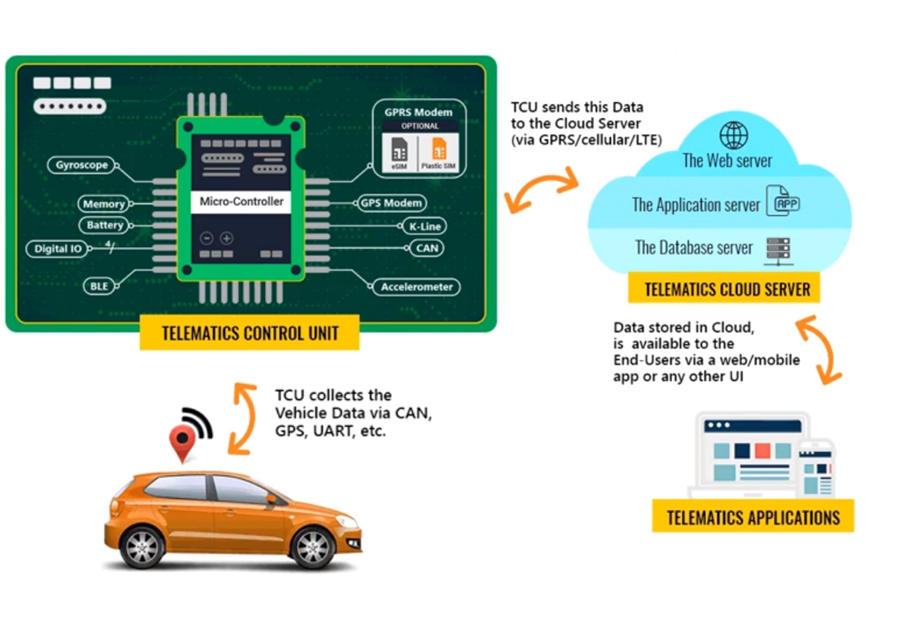
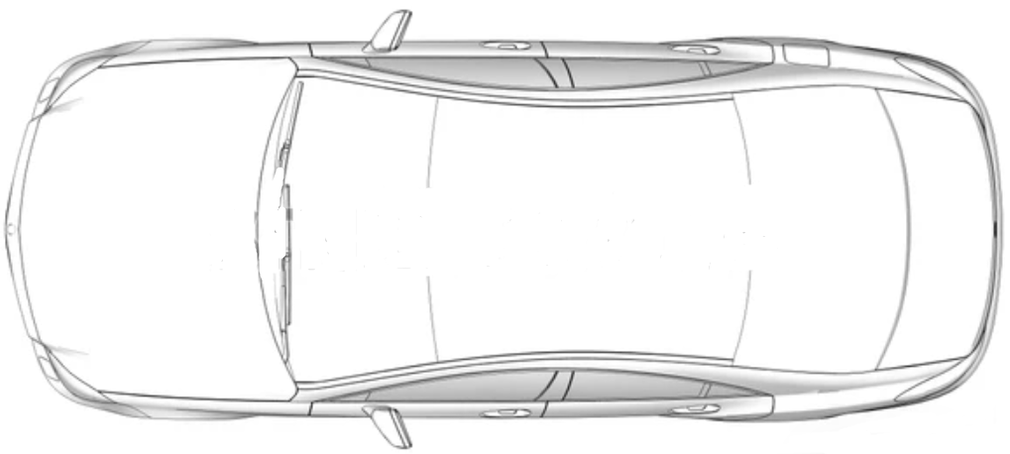

System Overview
Firmware & Software Update Release
where the users can get new updates for their systems or send diagnostics to get problems solved.
Provides the products with Firmware system
Backend server/cloud
Communication Protocols.
OEM Firmware Update Provider
Firmware Updates sent to devices
ECU
ECU
TCU
GW
ECU
ECU
Telematics Unit
It’s the bridge connecting the server and the whole system allowing to send and receive multiple data through it.
Gate Way
Connects between TCU and all the product ECUs, get important data from the received update before sending it to the target ECU like ECU ID
Electronic Control Unit
An embedded system in automotive electronics controls one or more of the electrical systems or subsystems.

Slide 14
System Overview
Is that all?
Flashing Techniques for Microcontrollers
Flash is a type of non-volatile memory; that is, it's a memory that keeps the information transferred to it even when the power to the microcontroller is shut off… We need to get our program there
Off-Circuit Programming
In-System Programming
(ISP)
Bootloader
- The microcontroller shall be removed from its application circuit, and then connected to a burner
-The embedded devices can be programmed while installed in a complete system
- the bootloader checks to see if there is an upload request When you power up or reset your microcontroller board
- When the file is uploaded to the flash using the burner, the microcontroller can be connected again to its application circuit.
- A flash driver is needed to get the required application code, this is done by the available communication protocols in the embedded device (Target Specific)
- If there is, it will upload the new program and burn it into Flash memory. If not, it will start running the last program that you loaded.
- Not relevant to be used in automotive applications.

Slide 15
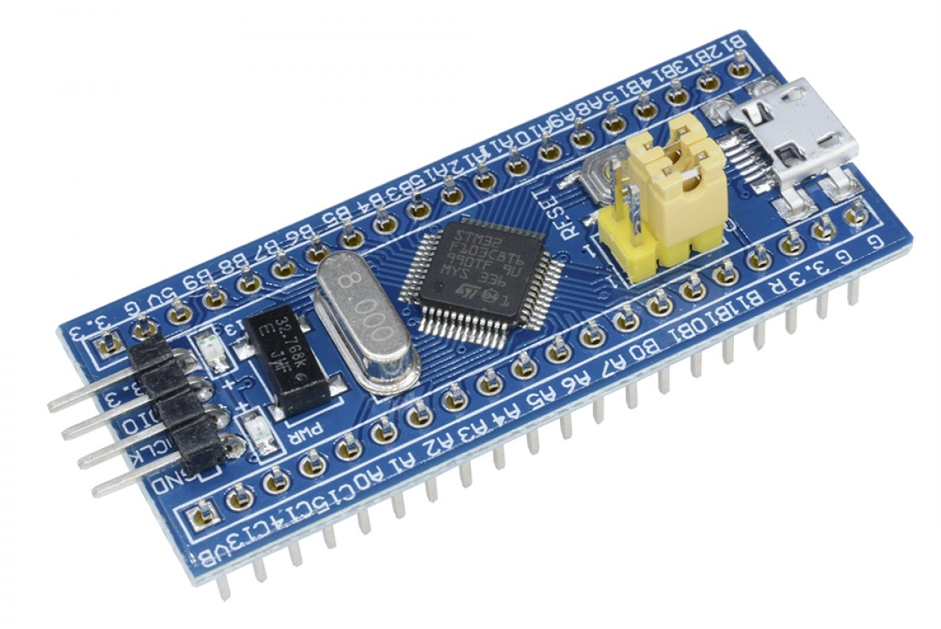
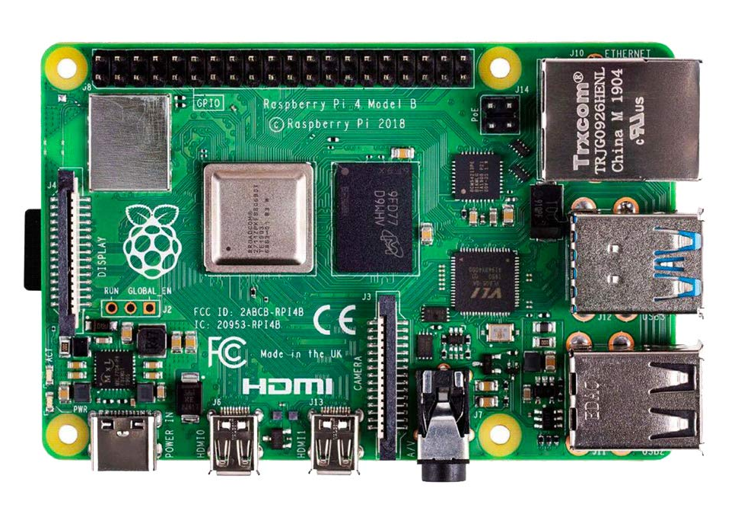
Server OEM
Telematics unit (ESP32)
Wi-Fi
Main ECU
UART
Gateway
STM32
Main ECU
APP ECU
Telematics unit
APP ECU
Gateway
CAN network
CAN network
Can Transceiver
MCP 2551
Can Bus
STM32 IC
ARM-based microcontroller
STM32 IC
ARM-based microcontroller
ESP32 module
Has a Wi-Fi module established by Arduino IDE
STM32 IC
ARM-based microcontroller
Can Transceiver
MCP 2551
Can Transceiver
MCP 2551
Can Transceiver
MCP 2551
+ Touch Screen
Engine system
Collision system
Temperature
Monitoring
User ECU
STM32
App ECU1
App ECU2
User
ECU
App
ECU
UART
Raspberry Pi 4
Engine system
Collision system
Temperature Monitoring

Slide 16
Communication Protocols

Slide 17
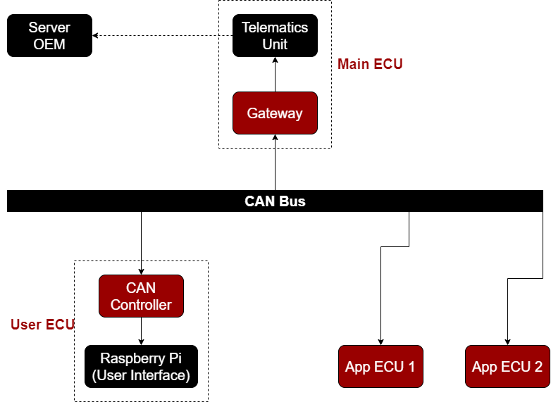
Communication Protocols

Slide 18
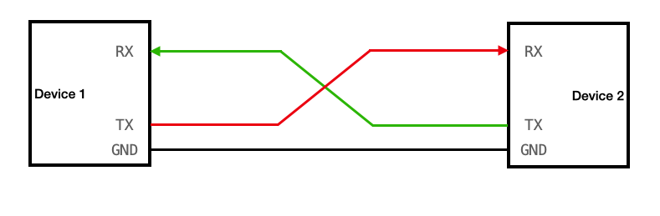
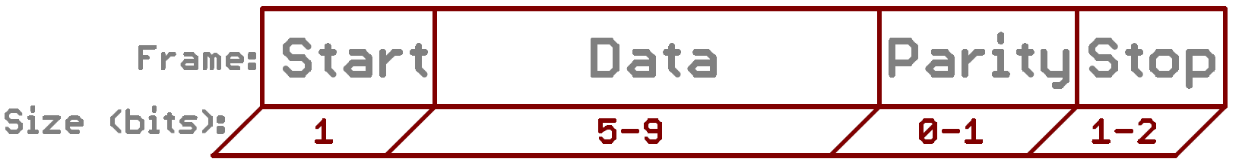
UART protocol
Universal Asynchronous Receiver/Transmitter
Connection
Frame Format

Slide 20
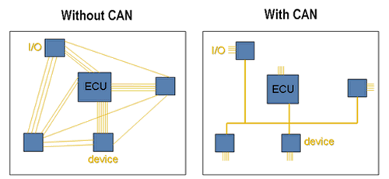
CAN Network
Controller Area Network

Slide 21
CAN Features
Low Cost
Speed
Multi-Master
Message based, not address based
Built-in Error Detection
Stable

Slide 22
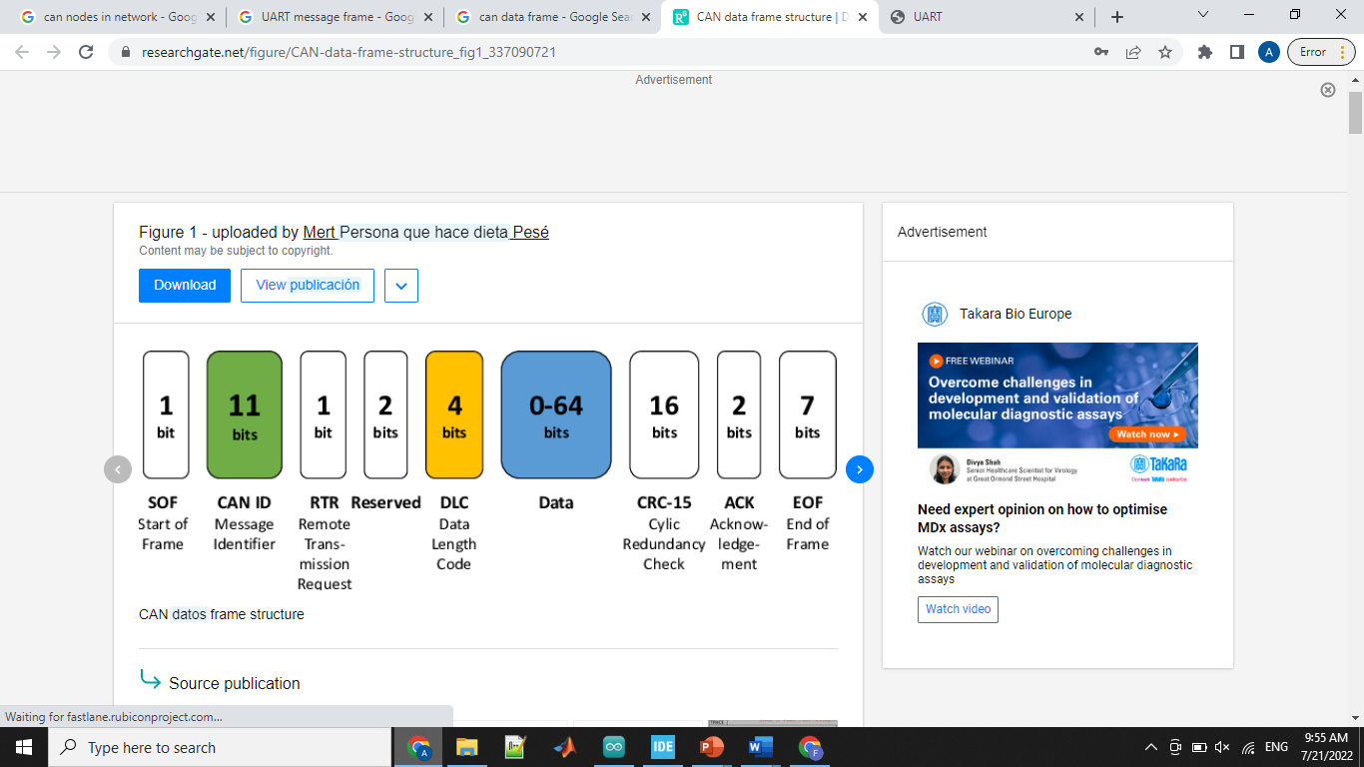
Message Types
Data Frame
Remote Frame
Error Frame
Overload Frame

Slide 23
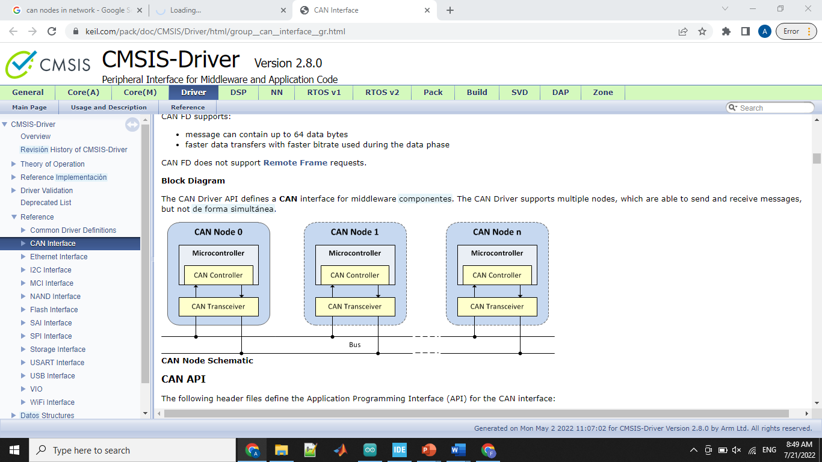
CAN Interface

Slide 24
CAN Operation
Message Transmission
Identifier List Mode
Message Filtering
Identifier Mask Mode
Message Reception

Slide 25
Bootloader

Slide 26
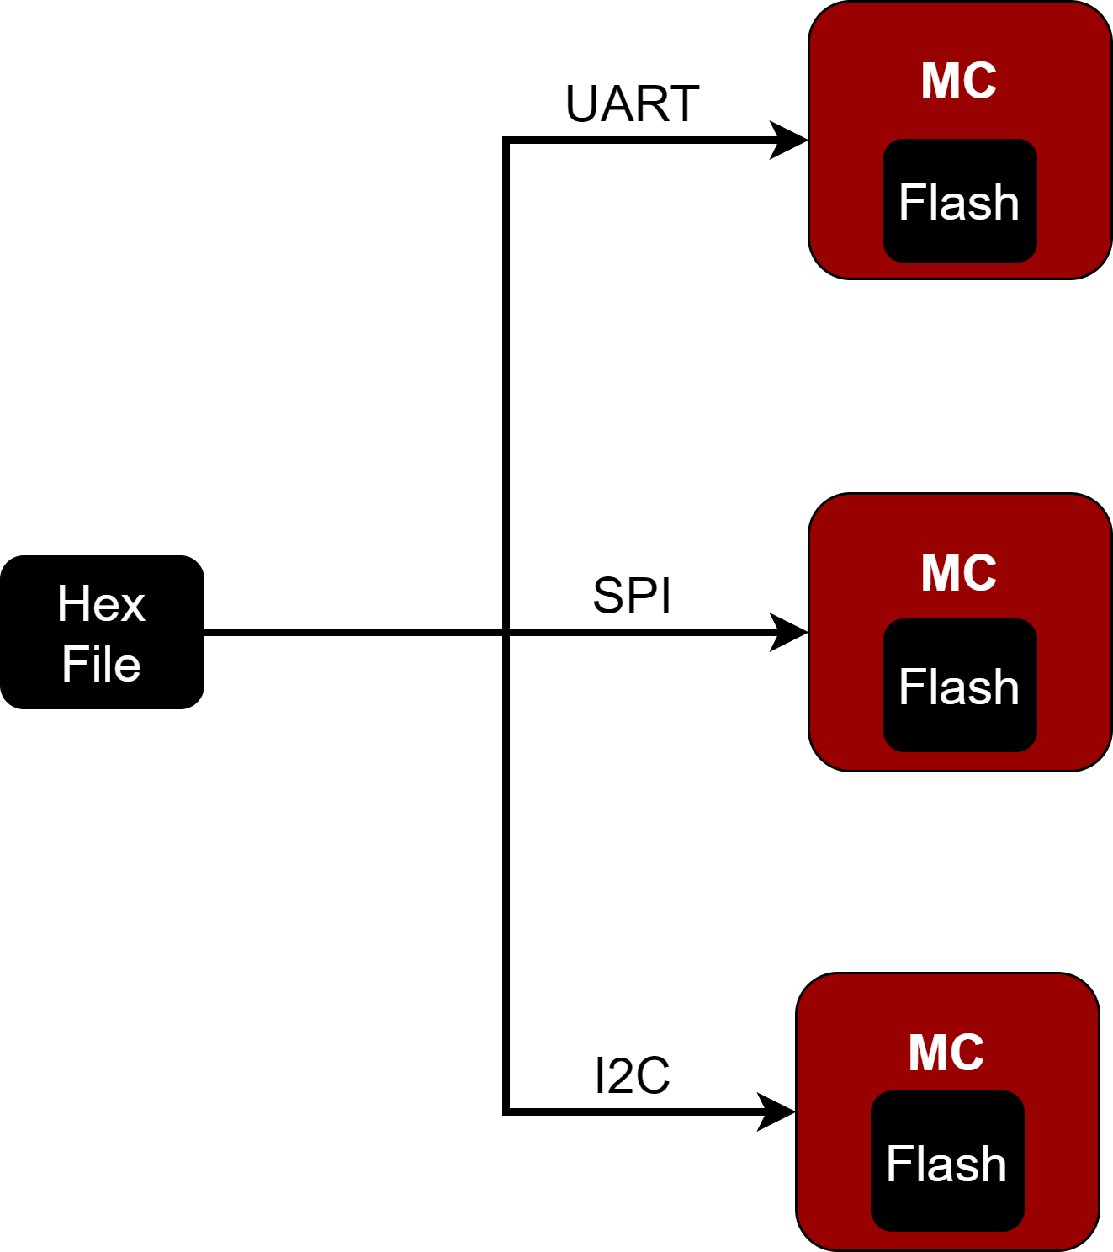
Bootloader
Flashing on MCU.
Automotive Industry.
Disadvantage.

Slide 27
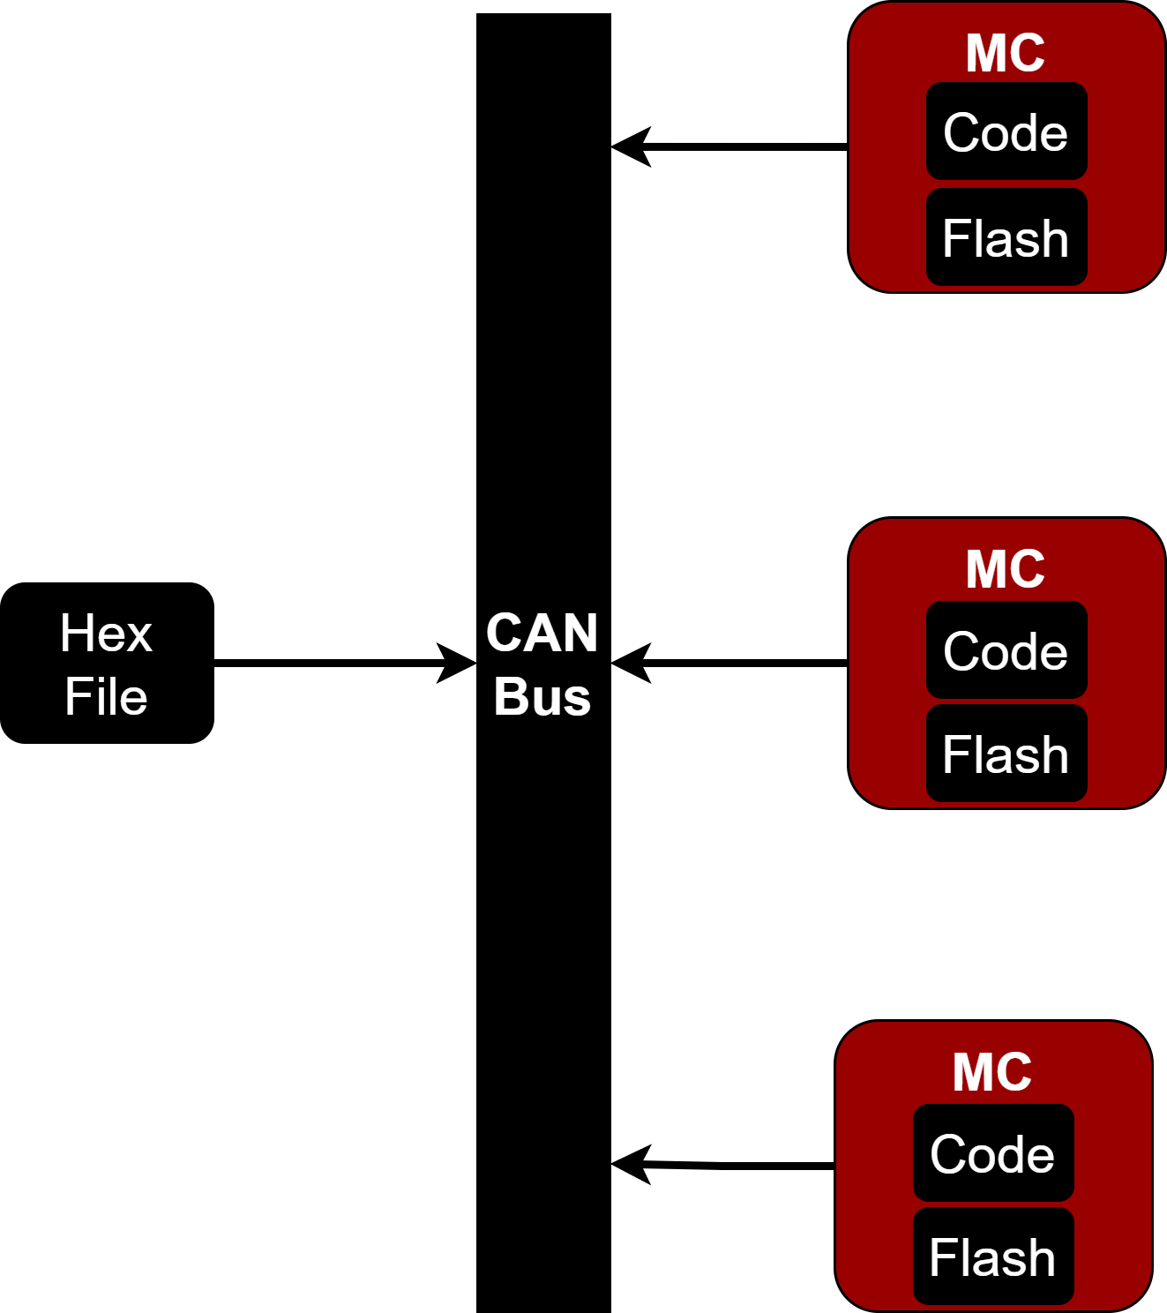
Bootloader
Solving The Problem.
Bootloader.

Slide 28
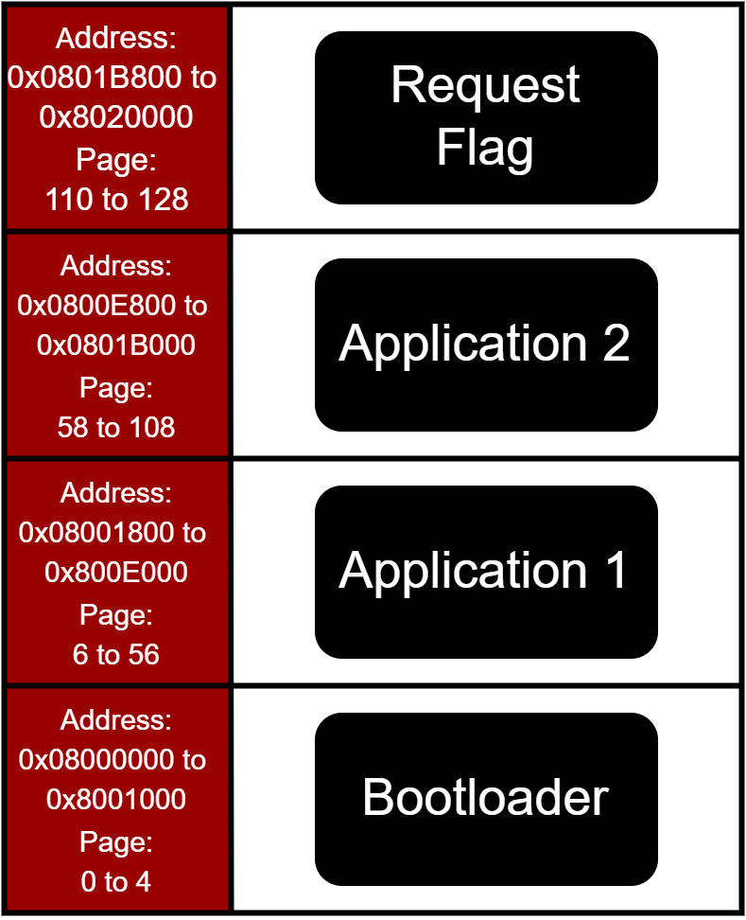
Bootloader
Memory Hierarchy

Slide 29
Bootloader
Implementation
FPEC Driver
Parsing Driver
Hex File Format
:CCAAAATTXXXXX……XXSS
Bytes # Address Data Type Data Checksum

Slide 30
Bootloader
Checksum
. . . . . . . . . .
Record
Byte 1
Byte 2
Byte N-1
Checksum
Checksum = 2’s Complement ( + + + )

Slide 31
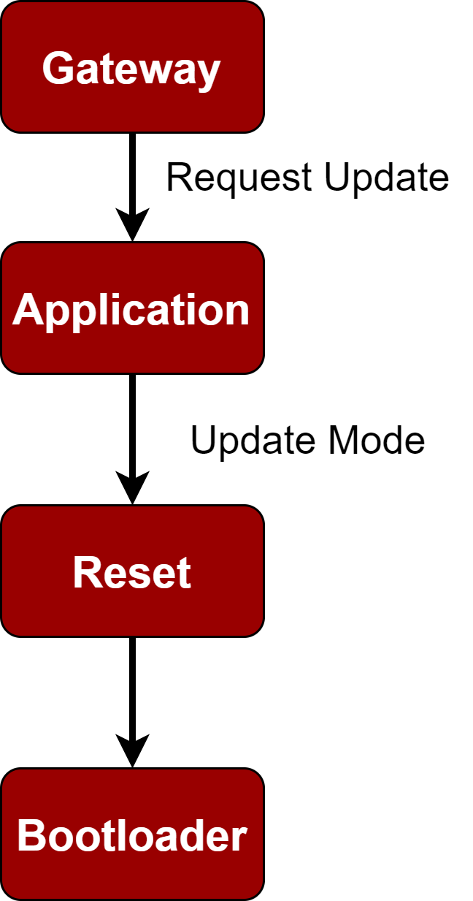
Bootloader
Scenarios

Slide 32
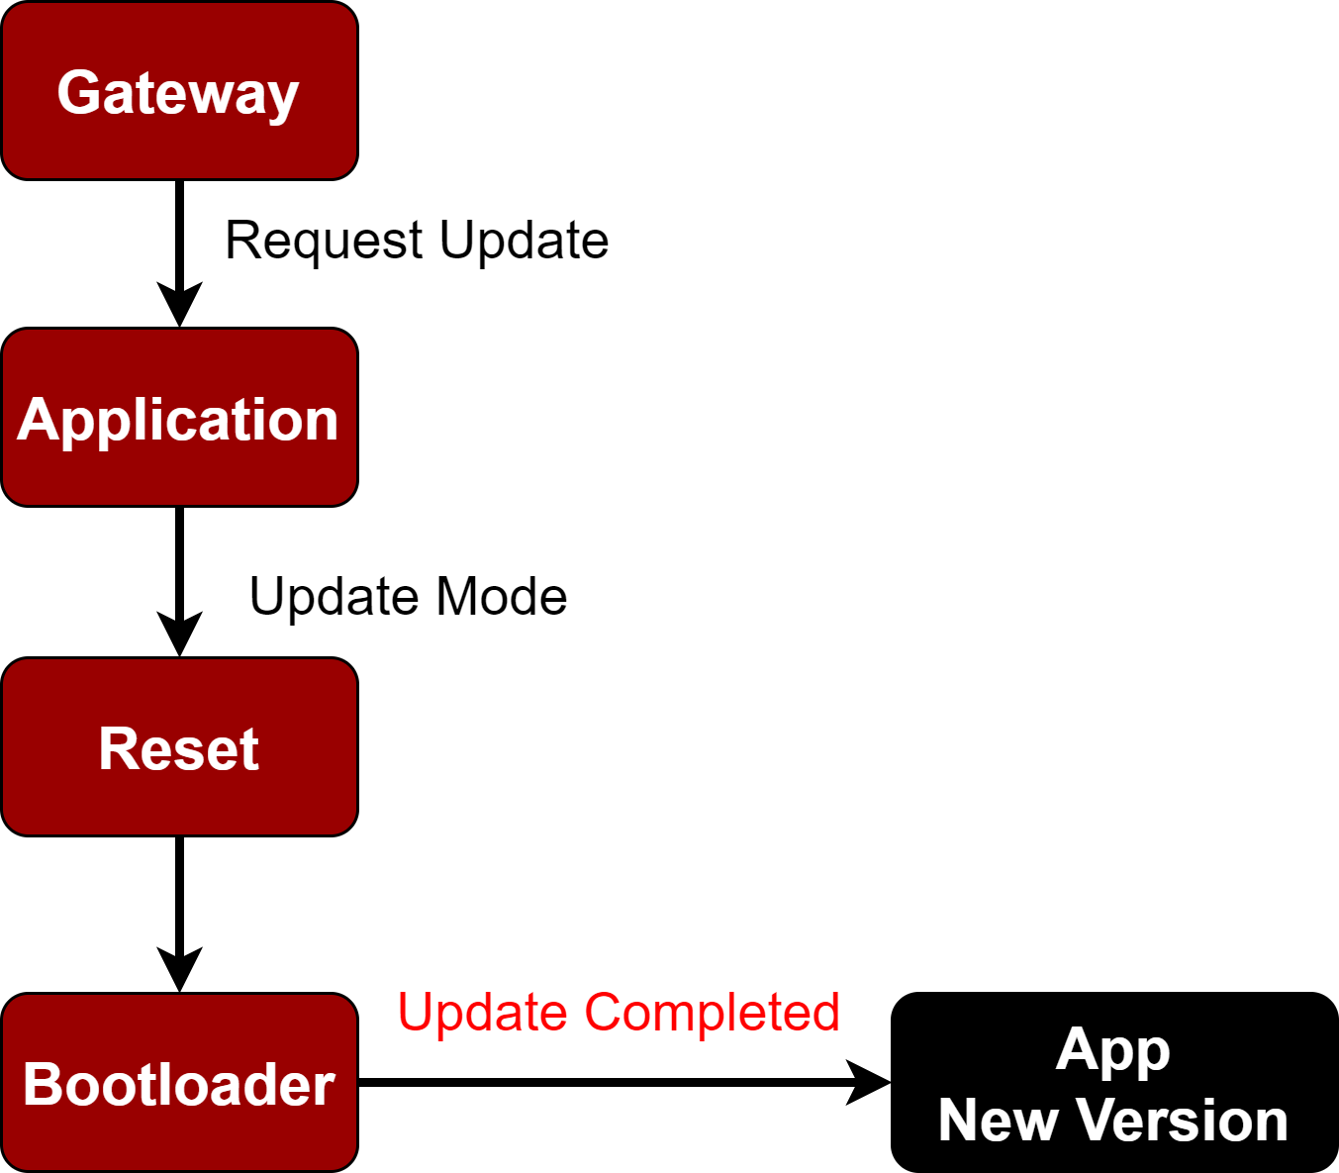
Bootloader
Update Complete

Slide 33
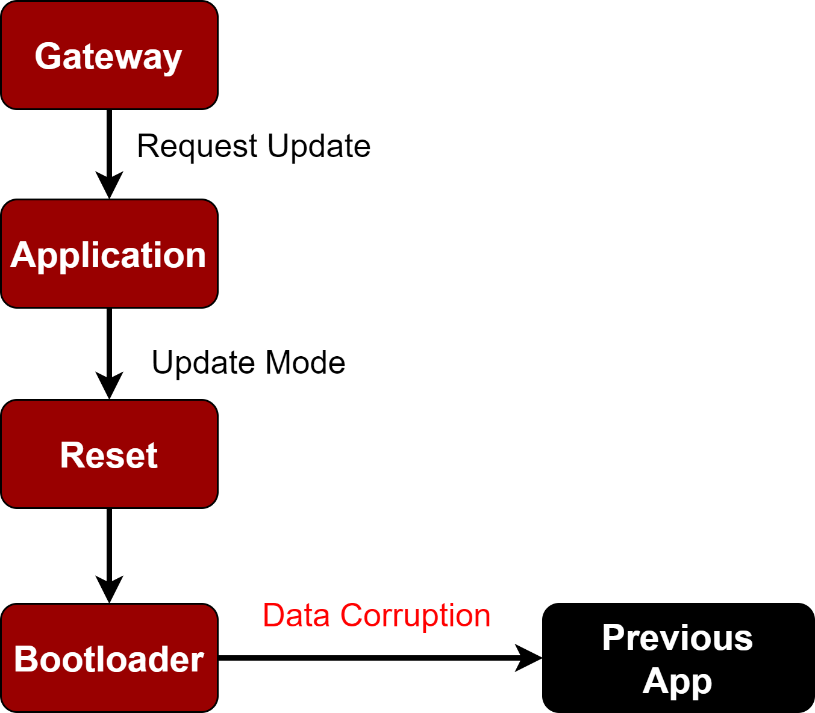
Bootloader
Data Corruption

Slide 34

Bootloader
Shut Down

Slide 35
Server

Slide 36


Server
Local Live Server
Real Time Hosted Service
Local Machine
Uptime
Storage
Rent the Service
Uptime
Storage Plan

Slide 37

Server
Real Time Hosted Service
Depends on Usage
Backend as a Service (BaaS)
Firebase

Slide 38
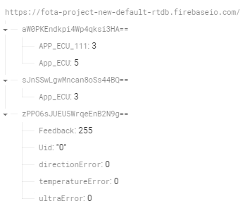
Server
Database

Slide 39
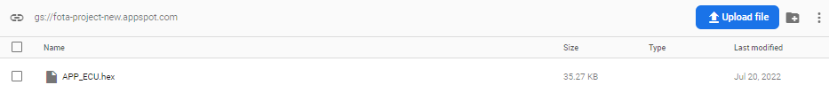
Server
Storage

Slide 40

Server
PyQt 5

Slide 41
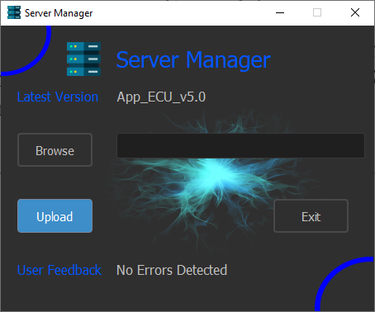
Server
Graphical User Interface

Slide 42

Encryption
Protect Company
Database
Private and Public Keys
Protect User Info
Secure FOTA

Slide 43
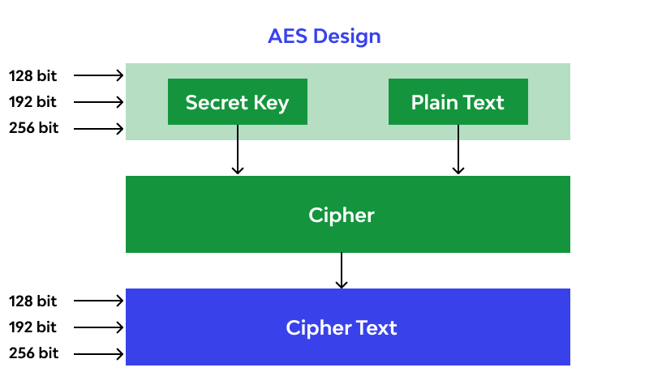
Encryption
Reliable.
Impossible to be brute forced.
128 bits.

Slide 44
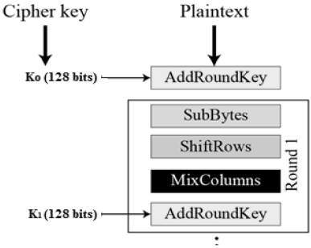
Encryption
abcd
String to byte (utf-8 reference only)
b’abcd’
Padding
b’abcd\---\---\---\---’
Encryption (utf-8 encode is included )
b’\---\---\---\---\---\---’
base64 encode & utf-8 decode
String on the server

Slide 45
Decryption
String on the server
base64 decode
b’\---\---\---\---\---\---’
Decryption (utf-8 encode is included )
b’abcd\---\---\---\---’
Unpadding
b’abcd’
Byte to string (utf-8 decode)
abcd

Slide 46
USER ECU
Raspberry Pi

Slide 47
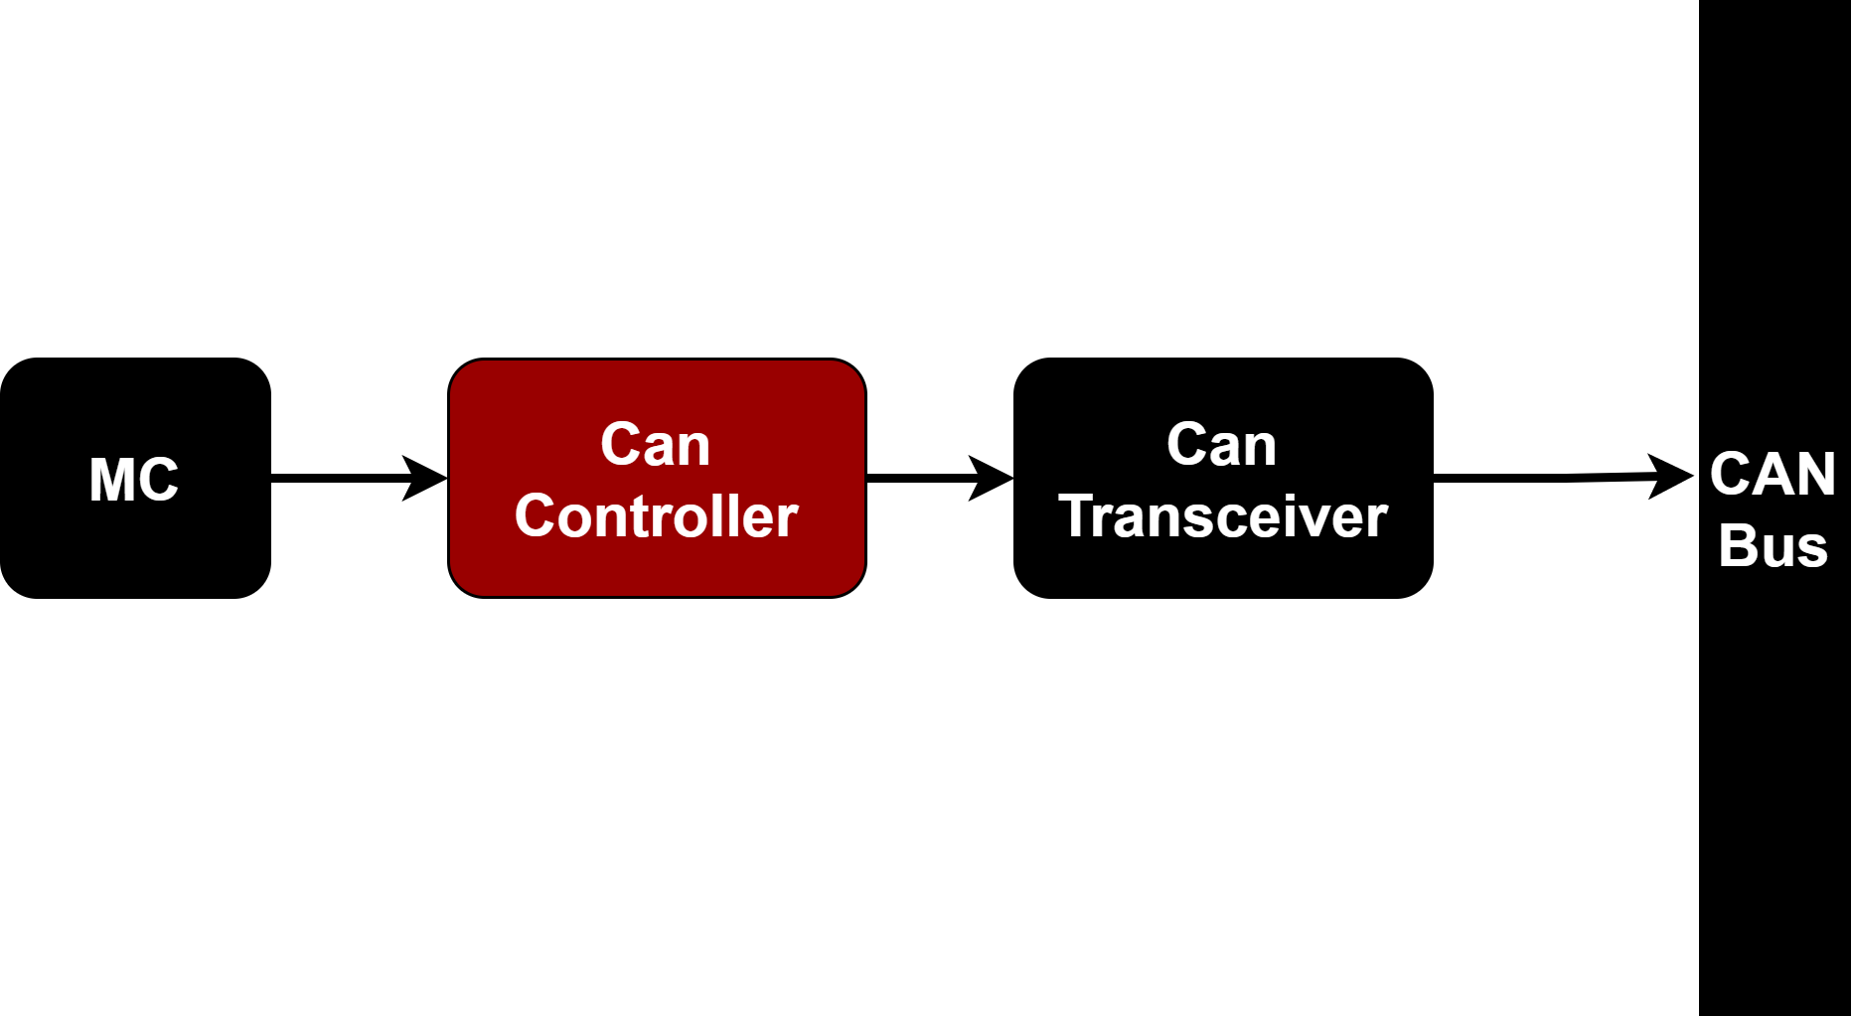
CAN Controller

Slide 48
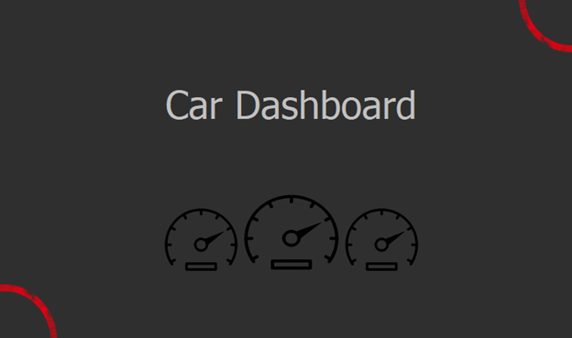
Raspberry Pi

Slide 49
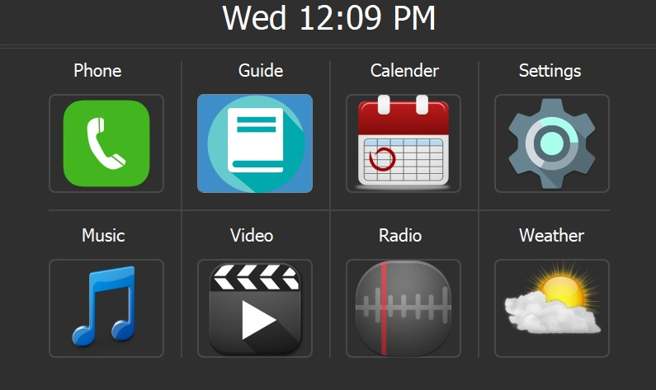
Raspberry Pi

Slide 50
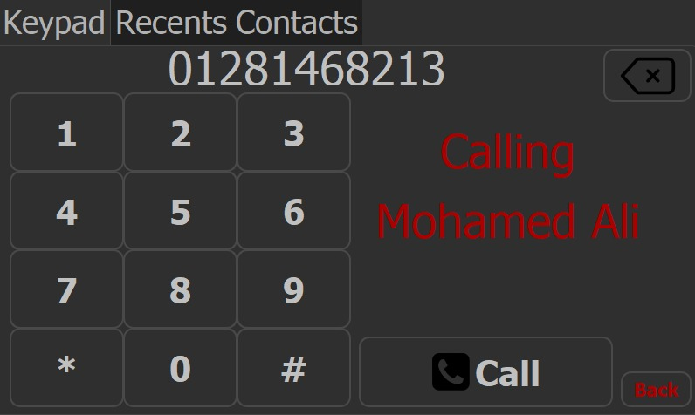
Raspberry Pi

Slide 51
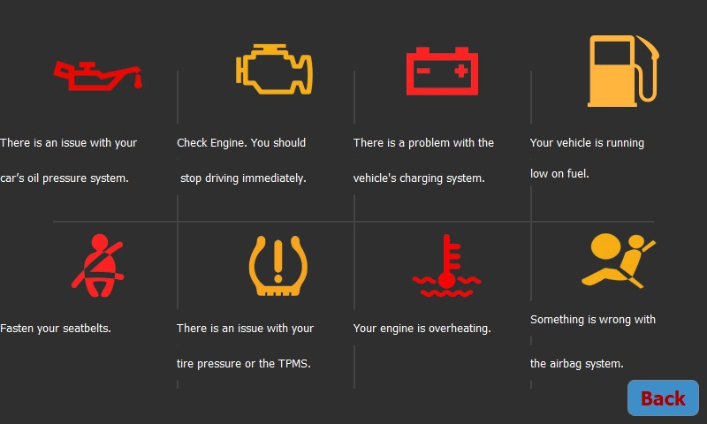
Raspberry Pi

Slide 52
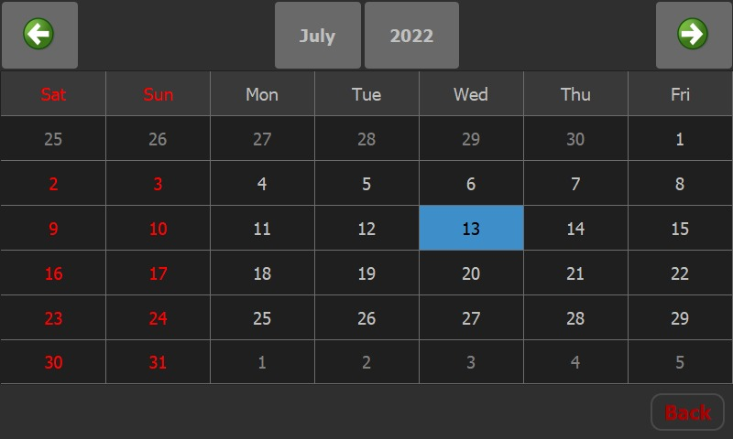
Raspberry Pi

Slide 53
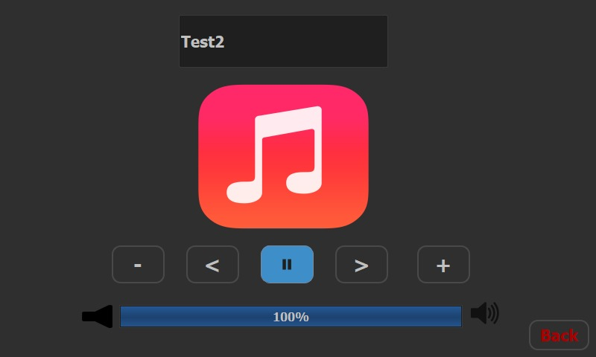
Raspberry Pi

Slide 54
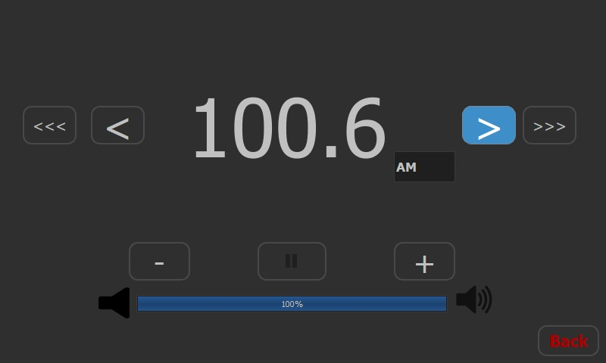
Raspberry Pi

Slide 55
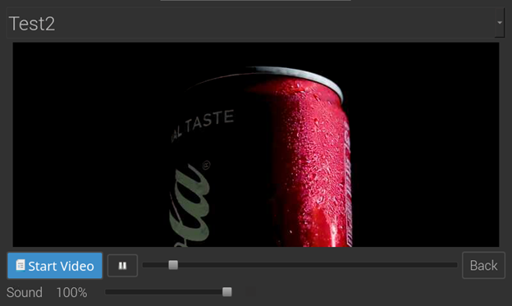
Raspberry Pi

Slide 56
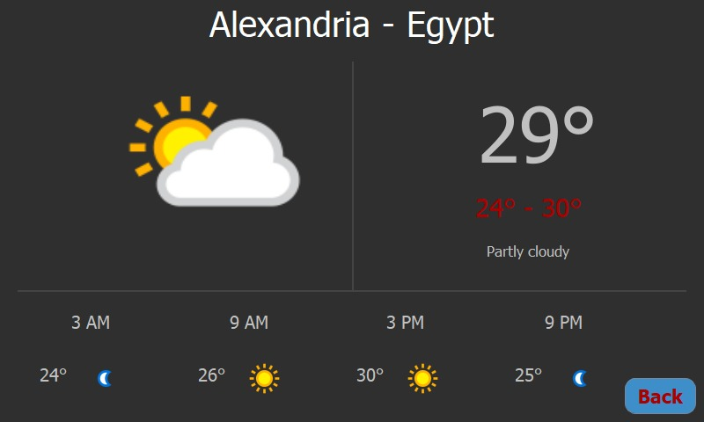
Raspberry Pi

Slide 57
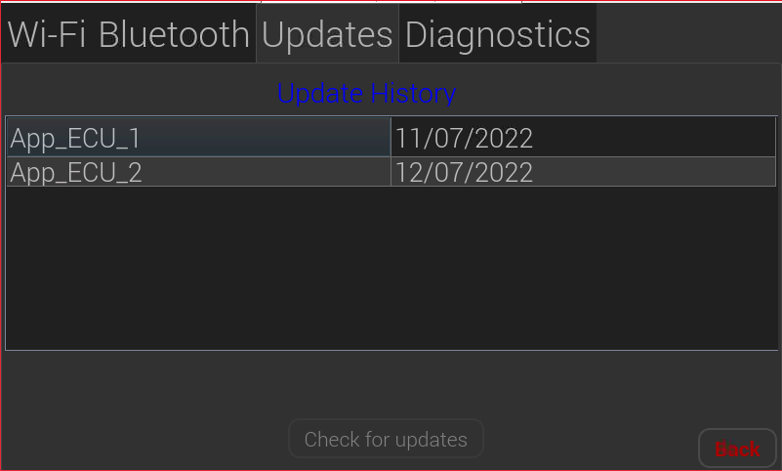
Raspberry Pi

Slide 58
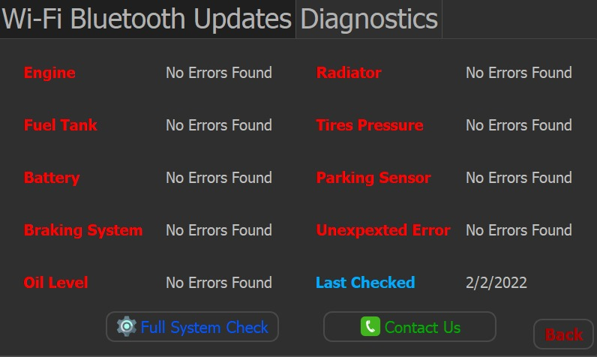
Raspberry Pi

Slide 59
USER ECU
STM 32

Slide 60
CAN Controller

Slide 61
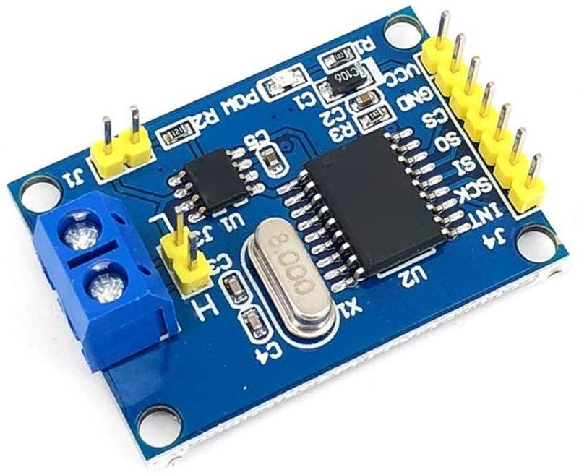
CAN Controller
CAN Bus to SPI

Slide 62
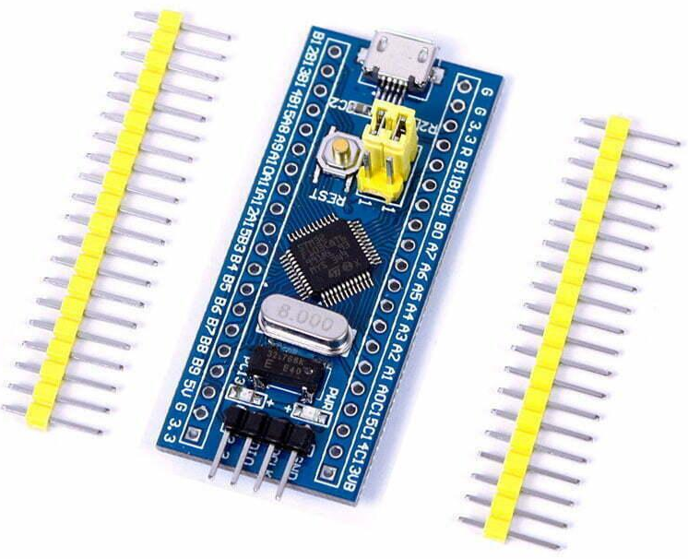
CAN Controller
STM32 + CAN Transceiver

Slide 63
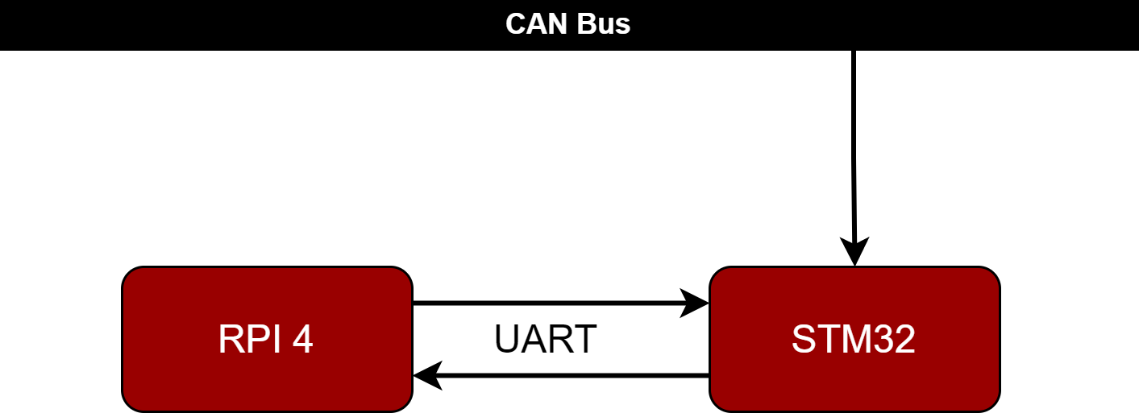
CAN Controller
Solution

Slide 64
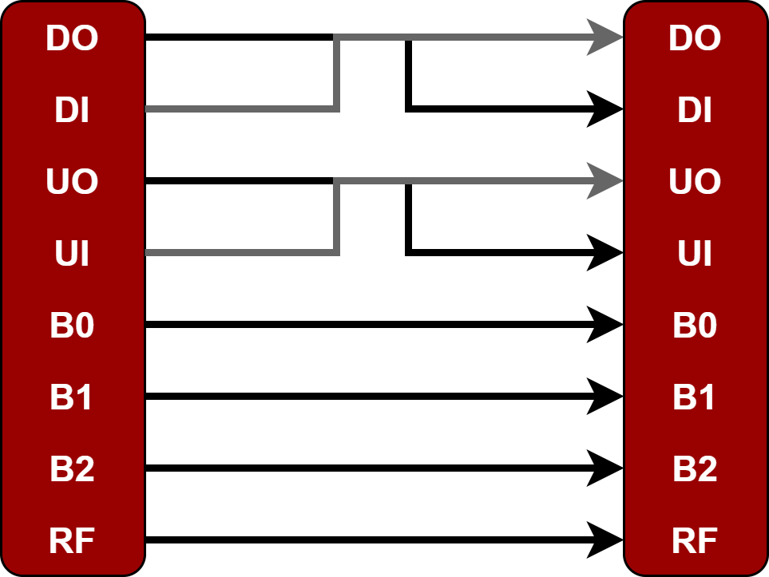
CAN Controller
Asynchronous Octal Communication (AOC)

Slide 65
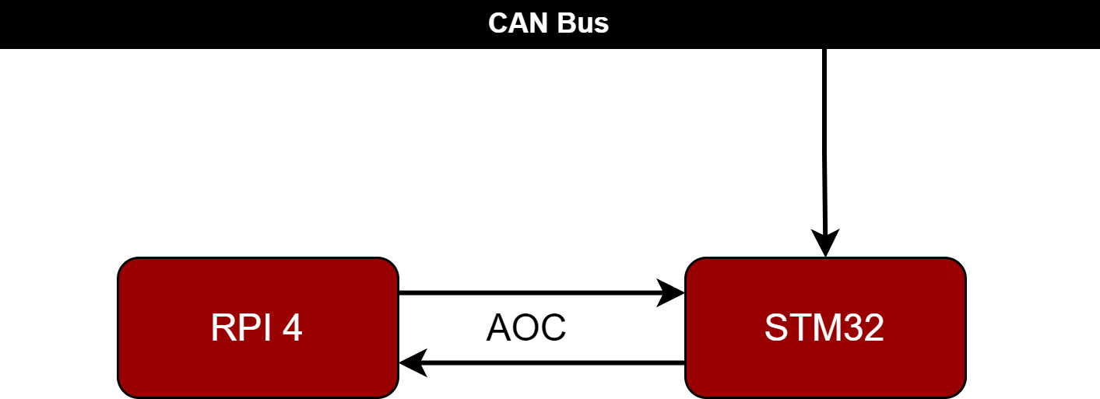
CAN Controller
Solution
Solution

Slide 66
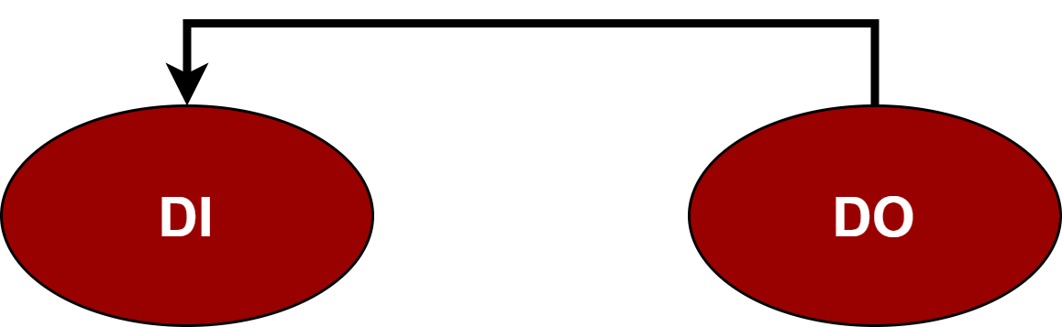
CAN Controller
Diagnostics Request from RPI to STM

Slide 67
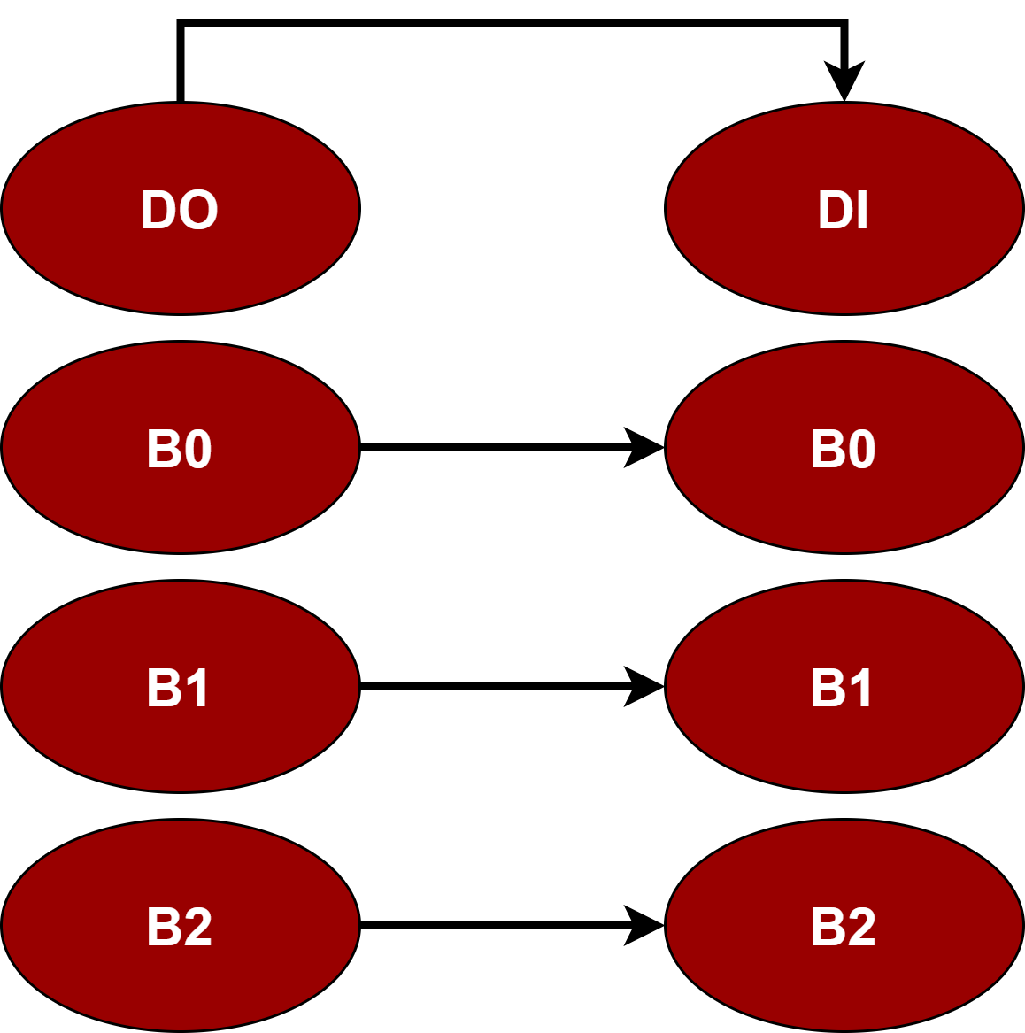
CAN Controller
Diagnostics Data from STM to RPI

Slide 68
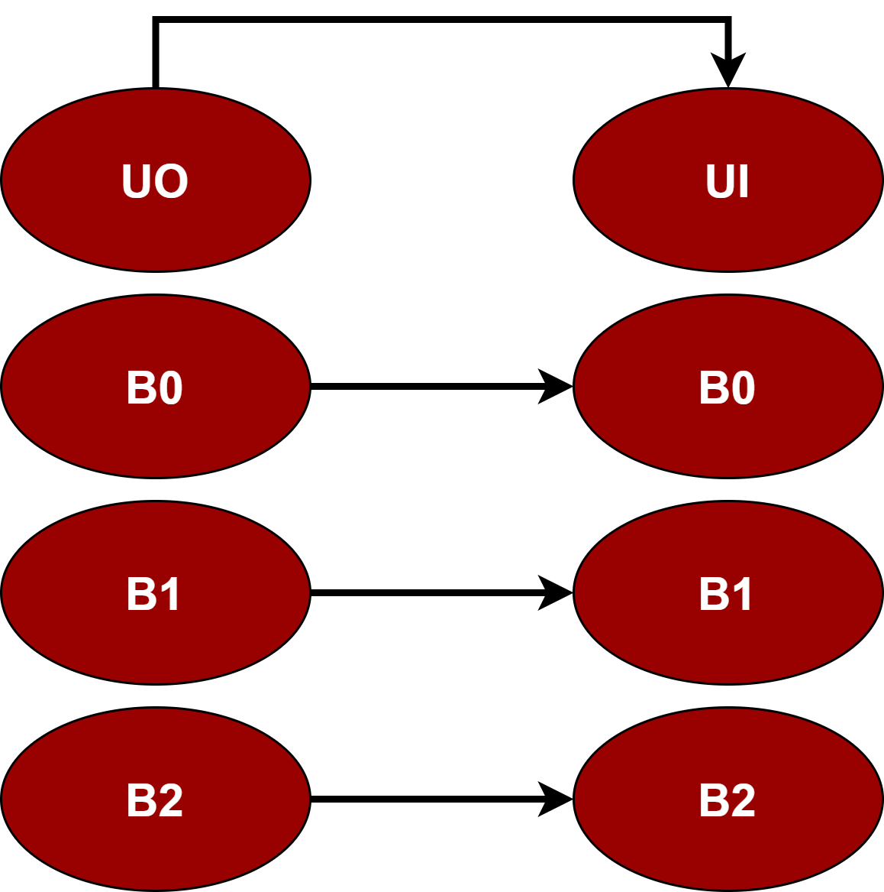
CAN Controller
Update Notification and Progress from STM to RPI

Slide 69
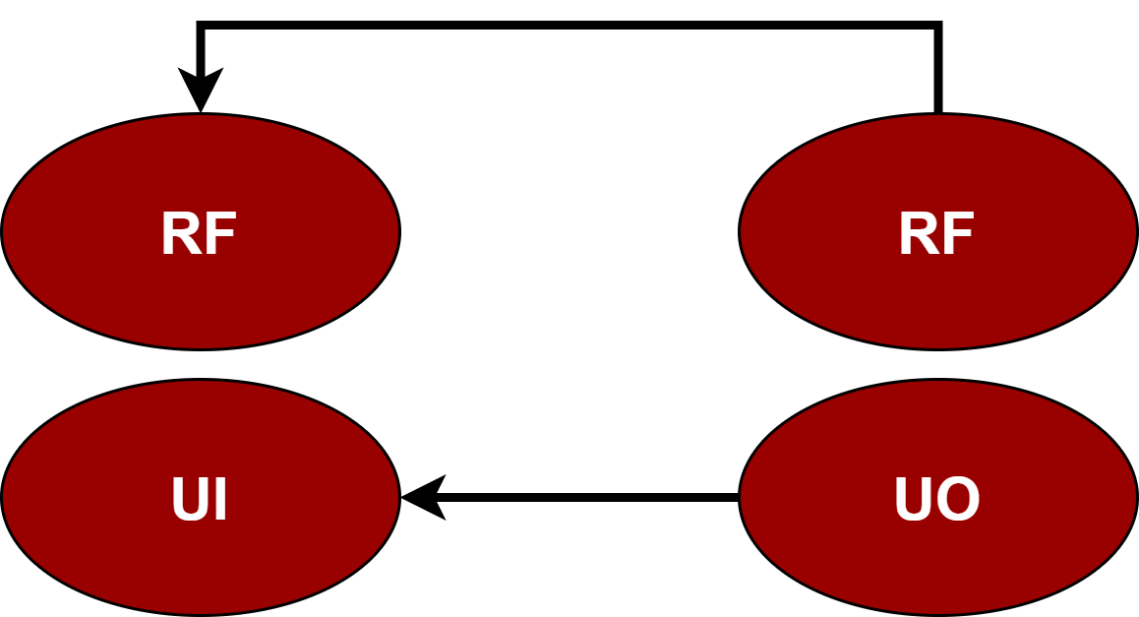
CAN Controller
Update Response from RPI to STM

Slide 70
RTOS
Real Time Operating System

Slide 71
RTOS
Super Loop vs Interrupts
while(1);
ISR1(void){
…
}
ISR2(void){
…
}
while(1)
{
Task1();
Task2();
Task3();
}

Slide 72

RTOS
Super Loop vs Interrupts
while(1)
{
Task1();
Task2();
Task3();
}
Responsiveness

Slide 73
RTOS
Super Loop vs Interrupts
while(1);
ISR1(void){
…
}
ISR2(void){
…
}
Determinism

Slide 74

RTOS
Real Time Operating System
Determinism
Responsiveness

Slide 75
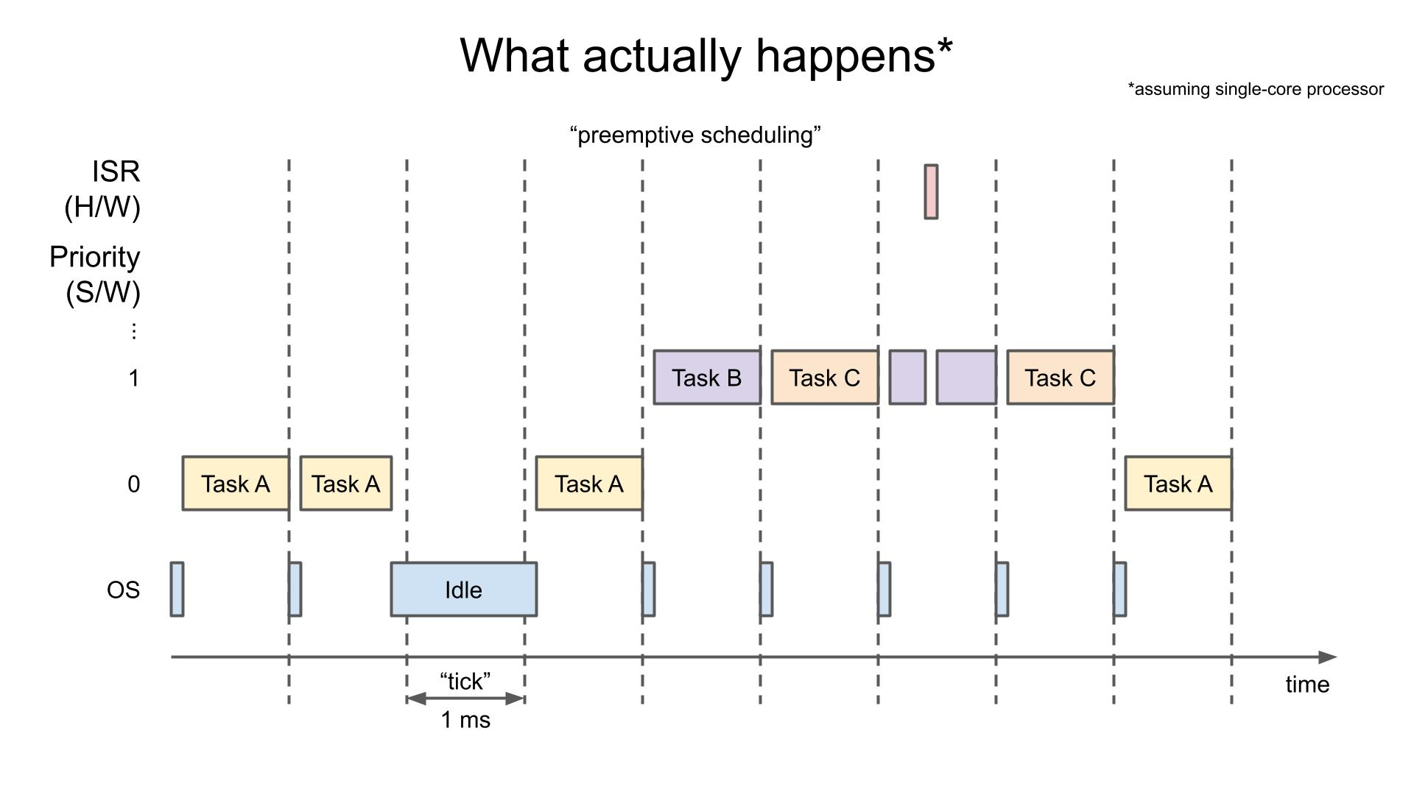
RTOS

Slide 76

RTOS

Slide 77
RTOS
Task 1
Task 3
Queue 1
Queue 2
Task 2
Task 4

Slide 78
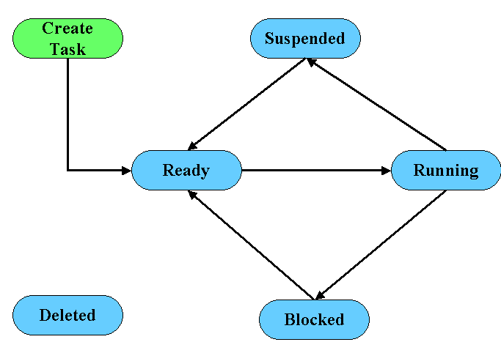
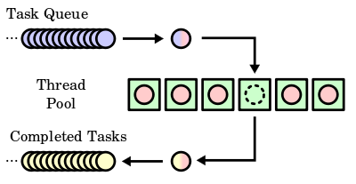
RTOS
Scheduler-Related Function
Task-Related Function

Slide 79
APP ECUs
Diagnostics

Slide 80
APP ECUs
FOTA Services
Diagnostics
Updates

Slide 81
APP ECUs
Why update is important?
Why diagnostics is important?
Example
Applicable Example

Slide 82

APP ECUs

Slide 83
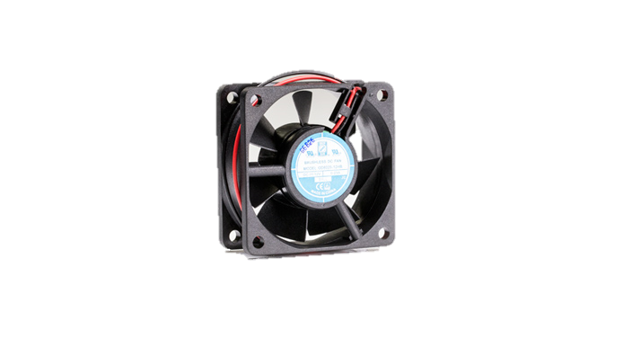
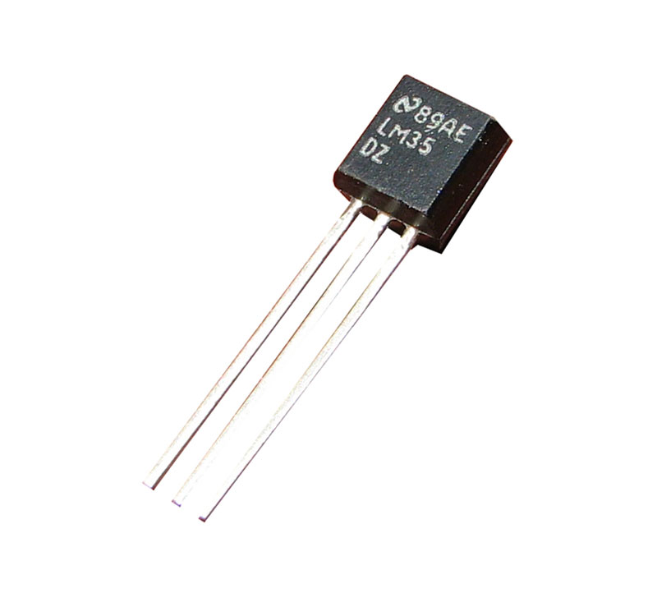
APP ECU 1
System 1
System 2

Slide 84



APP ECU 2
System 1
System 2

Slide 85


Diagnostics
Mode 1
Mode 2

Slide 86

Diagnostics
Data Base

Slide 87
MAIN ECU

Slide 88



MAIN ECU
Main Connection Between Server & System
Main ECU
Server
User System

Slide 89


MAIN ECU
Main Functions of Main ECU
Telematics Unit
Gateway Unit
Receive Update Request
Check for Update Version
Download Update File
Decryption of File
Send Update File
Handling of communication traffic between multiple ECUs
Send downloaded file to APP ECU
Receive diagnostics data

Slide 90



MAIN ECU
Components of Main ECU

Slide 91


MAIN ECU
How to Download Update File from Server to ESP32?
HTTP is connectionless
HTTP is media independent

Slide 92





MAIN ECU
Steps of Downloading Update File
Server Authentication / Connection with Server
Check Update Version / Download Update File
Providing API key and server authentication credentials to connect to server and allow access to fetch data.
Check version of update file from server RTDB and download file from the database and save it to SPIFFS.
Send file to Gateway using UART
Decryption of Update File
We use UART communication protocol to send data after receiving an acknowledgment to send the frame required.
Read file line by line then decode it using Base64 and decrypt each line using AES method.

Slide 93

MAIN ECU
Main Functions of Main ECU
 | Pending for User Acceptance
 | Send File to Direct APP ECU

Slide 94
Hardware

Slide 95


Hardware

Slide 96

Hardware

Slide 97
Future Work

Slide 98

Future Work
AUTOSAR
Delta File
Update
Flash
Corrupted
Section

Slide 99

Video

Slide 100
THANK YOU

